Slide 1

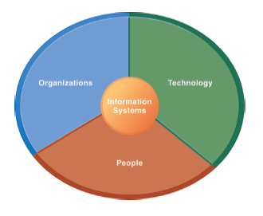
The Institute of Finance Management
ITU08117:
Information Systems Management
BAIT III
Mugyabuso, M. L
2023-2024
Notes:
There are two video cases and two instructional videos available for this chapter.

Slide 2
STUDENT LEARNING OUTCOMES
Use analytical tools to align business and information systems strategies
Use SWOC analysis to recommend sound information system for and organization
Use IS techniques to manage information system within organization
Notes:
Students may not know exactly what is meant by globalization or may have an incomplete understanding of the term. You might ask students what they think it means. What are some examples of globalization in their personal lives? Cars come to mind, but there are thousands of products sold in the United States that are produced offshore. Why is globalization growing in strength? Potential answers could include: reduction of economic and cultural advantages of developed countries, increased number of companies with operations in multiple countries worldwide, and increased reliance on imports and exports of goods (and jobs). Globalization will be discussed in later slides as well.

Slide 3
STUDENT ASSESSMENT PLAN
There will be three marked and recorded assessments
Comprehensive Test (20%)
Group Assignment (20%)
Final End of Semester Examination (60%)
ITU08117 does not encourage or plan to have any special assessment, it has to be to only SPECIAL students. So don’t try this.

Slide 4
The Role of Information Systems in Business Today
How Information Systems Are Transforming Business
In 2019, more than 100 thousand businesses had “DOT-TZ” addresses registered in Tanzania
More than 25 million people receive their news online; 20 million Tanzanians read blogs.
Internet advertising continues to grow at around 14 percent per year.
Changes in business result in changes in jobs and careers.
New laws require businesses to store more data for longer periods.
Tanzania Cyber Crime Act 2015
Tanzania Data Protection Act 2022
Notes:
Ask students to explain why these items are examples of information systems transforming business. What industries are especially hard hit with disruptions and change due to IT?

Slide 5
The Role of Information Systems in Business Today
What’s New
New technologies
Cloud computing
Software as a service (SaaS)
Mobile digital platform
People and behavior changes
Managers use social networks, collaboration
Business intelligence applications accelerate
Virtual meetings are accepted and used
Organizations
Web 2.0 applications widely adopted
Telework gains momentum
Co-creation of value, collaboration across firms

Slide 6
The Role of Information Systems in Business Today
Globalization Challenges and Opportunities:
A Flattened World
Internet and global communications have greatly reduced economic and cultural advantages of developed countries.
Drastic reduction of costs of operating and transacting on global scale
Competition for jobs, markets, resources, ideas
Dependence on imports and exports
Requires new understandings of skills, markets, opportunities
Notes:
You could ask students to name ways in which globalization affects their everyday lives. Ask them how they might react if they learned that a job opening they coveted was outsourced to another country, or on the other hand, what they would do if they were managers filling a job opening and workers from abroad could fill the spot for a fraction of the cost.

Slide 7
The Role of Information Systems in Business Today
Business Drivers of Information Systems
Businesses invest in IT to achieve six important business objectives.
Operational excellence
New products, services, and business models
Customer and supplier intimacy
Improved decision making
Competitive advantage
Survival
Notes:
Which objective do students consider to be most important? Ask students to describe their personal business experience as employers (or owners), and to describe which of the above objectives was most important in their firm or job.

Slide 8
The Role of Information Systems in Business Today
1. Operational Excellence:
Improved efficiency results in higher profits.
Information systems and technologies help improve efficiency and productivity.
E.g., Azam
Power of combining information systems and best business practices to achieve operational efficiency
Most efficient store products distribuion as result of digital links between suppliers and stores
Notes:
Describe to students why it is that digital links between suppliers and stores would improve efficiency (critical information travels faster, better control over inventory levels).
Walmart is the most efficient retailer in the industry and exemplifies operational excellence. You could ask students to name other businesses that they believe exhibit a high level of operational excellence. Do customers perceive operational excellence? Does it make a difference for customer purchasing? What Web sites strike students as really excellent in terms of customer service? If you have a podium computer, you might want to visit the Walmart site and the Amazon site to compare them in terms of ease of use.

Slide 9
The Role of Information Systems in Business Today
2. New Products, Services, and Business Models:
Information systems and technologies enable firms to create new products, services, and business models.
Business model: how a company produces, delivers, and sells its products and services
E.g., Netflix
Transformed old model of movie distribution an App
Notes:
You could ask students to name other new products or business models that they have encountered and how they might relate to new information systems or new technology. One way to encourage participation is ask students to help you list on the blackboard some really interesting recent digital product innovations. Discussing “green technologies” like wind, solar, and hybrid vehicles is always fun. The impact of smartphones and table computers is also a fun topic for students. In this context, what role will IT be playing in the development of these technologies?

Slide 10
The Role of Information Systems in Business Today
3. Customer and Supplier Intimacy:
Customers who are served well become repeat customers who purchase more.
Eg. AirBnB, Uber and Bolt
Uses IT to foster an intimate relationship with its customers, keeping track of preferences, and so on
Close relationships with suppliers result in lower costs.
Notes:
You could ask students what types of companies might rely more on customer and supplier intimacy more than others and which companies they feel have served them exceptionally well. Ask the students to identify online sites that achieve a high degree of customer intimacy. Sites to visit would include Netflix, Amazon, and other sites, which have recommended systems to suggest purchase ideas to consumers.

Slide 11
The Role of Information Systems in Business Today
4. Improved Decision Making:
If managers rely on forecasts, best guesses, and luck, they will misallocate employees, services, and inventory.
Real-time data improves ability of managers to make decisions.
Verizon: Web-based digital dashboard to update managers with real-time data on customer complaints, network performance, and line outages
Notes:
You could ask students if they have ever been recipients of exceptional service from a company made possible by improved decision making and whether or not information systems contributed to that level of service. For example, perhaps they had a power outage and it took a very short (or very long) time for the company to correct the error.

Slide 12
The Role of Information Systems in Business Today
5. Competitive Advantage:
Often results from achieving previous business objectives
Advantages over competitors:
Charging less for superior products, better performance, and better response to suppliers and customers
Notes:
Emphasize that achieving any of the previous four business objectives represents the achievement of a competitive advantage as well.

Slide 13
The Role of Information Systems in Business Today
6. Survival:
Businesses may need to invest in information systems out of necessity; simply the cost of doing business.
Keeping up with competitors
Citibank’s introduction of ATMs
Federal and state regulations and reporting requirements
Toxic Substances Control Act and the Sarbanes–Oxley Act
Notes:
Ask students if they can name any examples of companies that failed to survive due to unwillingness or inability to update their information systems. Although difficult at first, think about the firms where the products or service were really unacceptable, or where returns were poorly handled. The Sarbanes–Oxley Act requires that public firms keep all data, including e-mail, for five years. You could ask students if they appreciate why information systems would be useful toward meeting the standards imposed by this legislation.

Slide 14
Perspectives on Information Systems and Information Technology
What Is an Information System?
Information technology: the hardware and software a business uses to achieve objectives.
Information system: interrelated components that manage information to:
Support decision making and control
Help with analysis, visualization, and product creation
Data: streams of raw facts.
Information: data shaped into meaningful, useful form.
Notes:
It’s important to understand that information systems are not just technologies, but deeply involve people and organizations as well. Being a great programmer does not qualify you for being a great manager of information systems.
Ask students to think of a stream of raw facts (data), and then an organized body of data (information). A stream of facts example is the ticker tape of a stock market (you can go to a Web site to display the streaming stock prices. Summary indices of stock movements and reports on stock groups (e.g., housing, transportation) constitute information.

Slide 15
Perspectives on Information Systems and Information Technology
What Is an Information System?
Activities in an information system that produce information:
Input
Processing
Output
Feedback
Sharp distinction between computer or computer program versus information system
Notes:
Use an example similar to the one given in the previous slide to illustrate the three activities involved in the function of an information system. Continuing with that example, the process of asking students their age would represent input, calculating the average age and determining the oldest and youngest age would represent processing, and writing that information on the board would represent output.

Slide 16
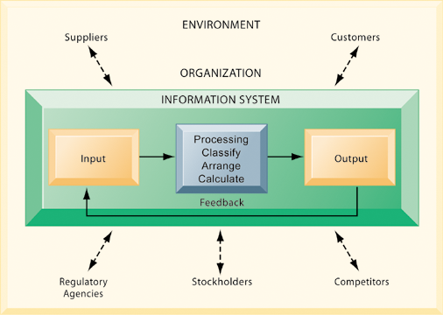
It Isn’t Simply Technology: The Role of People and Organizations
Functions of an Information System
An information system contains information about an organization and its surrounding environment. Three basic activities—input, processing, and output—produce the information organizations need. Feedback is output returned to appropriate people or activities in the organization to evaluate and refine the input. Environmental actors, such as customers, suppliers, competitors, stockholders, and regulatory agencies, interact with the organization and its information systems.
Figure 1-2
Notes:
The point of this diagram is first of all to highlight the three basic activities of information systems, so that students can understand what an information system is doing at its most fundamental level. But the diagram also puts information systems into the context of organizations (firms), and then puts the firm into its respective environment composed of shareholders, higher level authorities (government), competitors, suppliers, and customers. Suddenly, students should see that information systems play a central role mediating and interacting with all these players. Hence, systems play a key role in the operations and survival of the firm.
You could also explain this diagram by relating it back to the opening case, as the book does. The two types of input into the Synergy system are manually entered data as well as video. The system processes that data and creates the output, video, and statistics about specific types of players and plays.

Slide 17
It Isn’t Simply Technology: The Role of People and Organizations
The Role of People and Organizations
Information systems literacy
Includes behavioral and technical approach
Computer literacy
Focuses mostly on knowledge of IT
Management information systems (MIS)
Focuses on broader information systems literacy
Issues surrounding development, use, impact of information systems used by managers and employees
Notes:
It takes many different skills to build and manage information systems.

Slide 18
It Isn’t Simply Technology: The Role of People and Organizations
Information Systems Are More than Computers
Using information systems effectively requires an understanding of the organization, people, and information technology shaping the systems. An information system provides a solution to important business problems or challenges facing the firm.
Notes:
These three themes (people, organizations, and technology) will reappear throughout the book. Understanding the interaction between these factors and information systems is known as information system literacy. Knowing how to optimize the relationship between technology, organizations, and people is the purpose of this book and course.

Slide 19
It Isn’t Simply Technology: The Role of People and Organizations
Dimensions of Information Systems
Organizations
Coordinate work through structured hierarchy and business processes
Business processes: related tasks and behaviors for accomplishing work
E.g., fulfilling an order, hiring an employee
May be informal or include formal rules
Culture embedded in information systems
E.g., Azam SARAFU services concern with placing service to customer first
Notes:
What types of issues and problems would occur in a company whose information systems did not accurately reflect its culture, or whose hierarchy was overly complex or poorly conceived?

Slide 20
It Isn’t Simply Technology: The Role of People and Organizations
Dimensions of Information Systems
People
Information systems require skilled people to build, maintain, and use them.
Employee attitudes affect ability to use systems productively.
Role of managers
Perceive business challenges
Set organizational strategy
Allocate human and financial resources
Creative work: new products, services
Notes:
The “people” dimension of systems is often the most difficult to get right. Technologies change all the time, people do not change very rapidly. In order to use technologies effectively, people need training, and they need to think intelligently about how their business works. Managers are the employees who attempt to understand organizational issues and challenges, and then use technologies to solve the issues and meet the challenges.

Slide 21
It Isn’t Simply Technology: The Role of People and Organizations
Dimensions of Information Systems
Technology
IT Infrastructure: foundation or platform that information systems built on
Computer hardware
Computer software
Data management technology
Networking and telecommunications technology
Internet and Web, extranets, intranets
Voice, video communications
Notes:
Obviously, information systems are based on technologies—computer hardware and software, and telecommunications equipment. These technologies are like the infrastructure of a building—the plumbing and electrical and mechanical features in a building. Technology is the platform that enables all the common systems applications from Apple iPhones to the Internet.

Slide 22
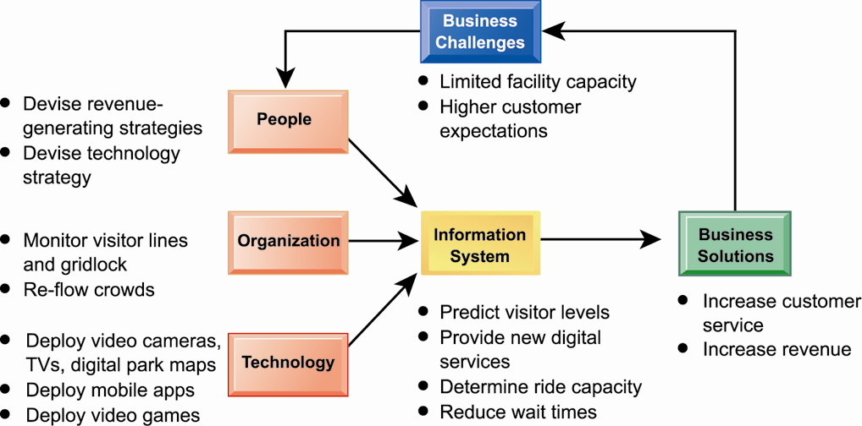
World Example of Usefulness of IS.
Shortening Lines at Disney World: Technology to the Rescue
Notes:
Can students think of any other business challenges faced by Disney which IT might help to alleviate?

Slide 23
NEXT
Understanding Information Systems: A Business Problem-Solving Approach
The Problem-Solving Approach

